Slide 1
BIOE 498 / BIOE 599: Computational Systems Biology for Medical Applications Lecture 2: Dynamical Systems Essentials
Joseph L. Hellerstein*
Herbert Sauro**
*eScience Institute, Computer Science & Engineering
**BioEngineering
Notes:
Diverse students. Some with bio-backgrounds; some without. Some with CS background; some with very limited. Two separate courses combined because of a substantial shared curriculum.

Slide 2
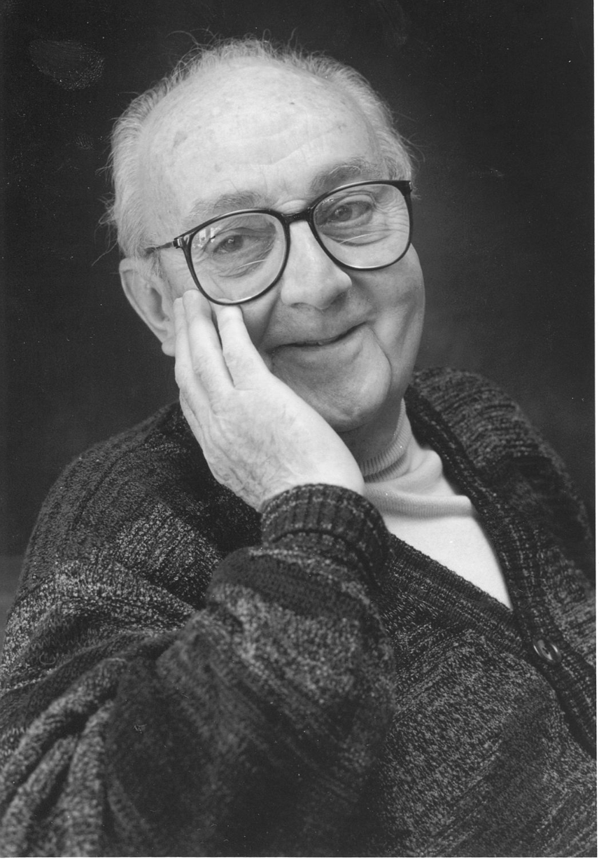
G.P.E. Box (Famous Statistician)
All models are wrong.
But some models are useful.

Slide 3
Reaction networks are dynamical systems.

Slide 4
Dynamical Systems*
A system in which a function describes the time dependence of a point in a geometrical space.
Examples include the mathematical models that describe: (a) the swinging of a clock pendulum, (b) the flow of water in a pipe, and (c) the number of fish each springtime in a lake.
*Wikipedia

Slide 5
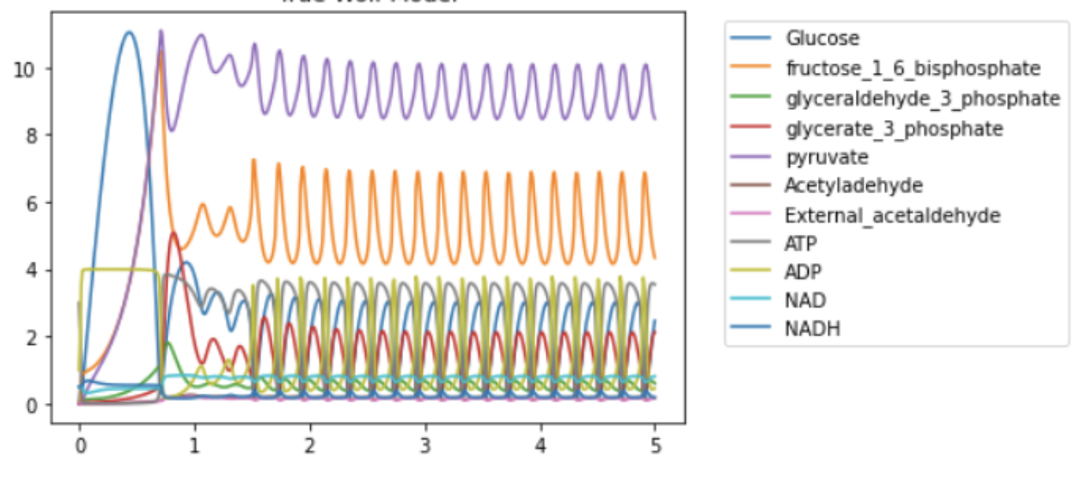
Glycolytic Oscillations*
Concentration
time (sec)
What is a point?
How do points evolve over time?
*Jana Wolf, BioModels 90
Notes:
What is a point? How do points evolve over time?

Slide 6
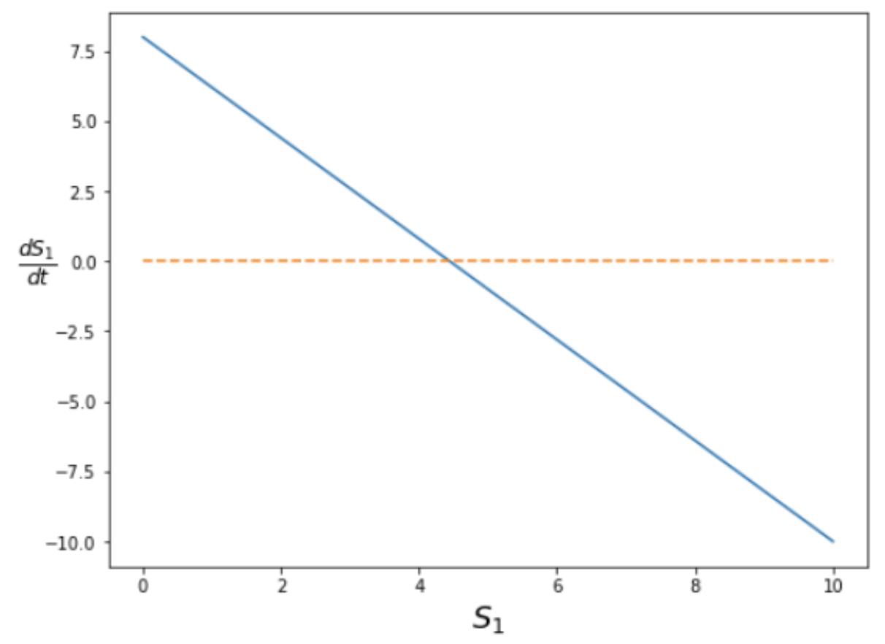
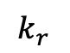
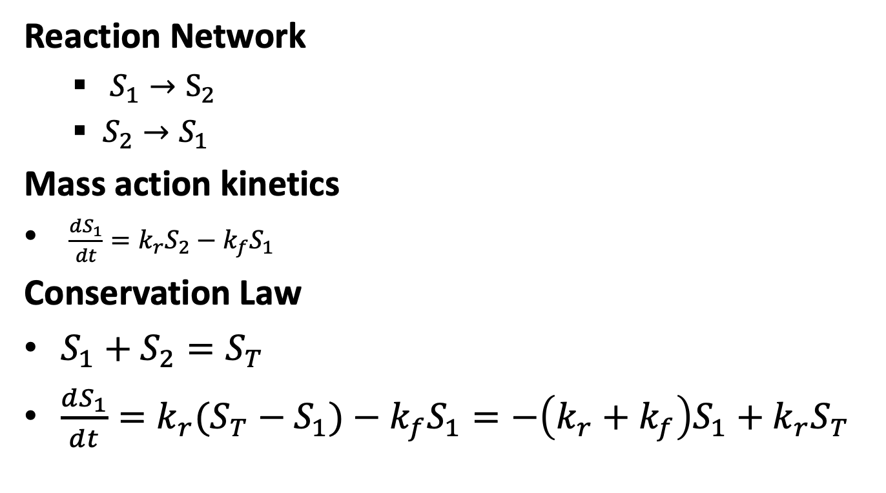
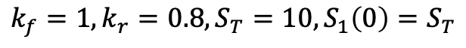
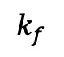
From Reaction to Dynamical Systems
Reaction Network
$S_{1}→S_{2}$
$S_{2}→S_{1}$
Mass action kinetics
$\frac{dS_{1}}{dt}=k_{r}S_{2}−k_{f}S_{1}$
Conservation Law
$S_{1}+S_{2}=S_{T}$
$\frac{dS_{1}}{dt}=k_{r}{(S_{T}−S}_{1})−k_{f}S_{1}=−\left(k_{r}+k_{f}\right)S_{1}+k_{r}S_{T}$
$$k_{f}=1,k_{r}=0.8,S_{T}=10,S_{1}\left(0\right)=S_{T}$$
$$k_{f}$$
$$k_{r}$$

Slide 7
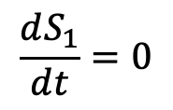
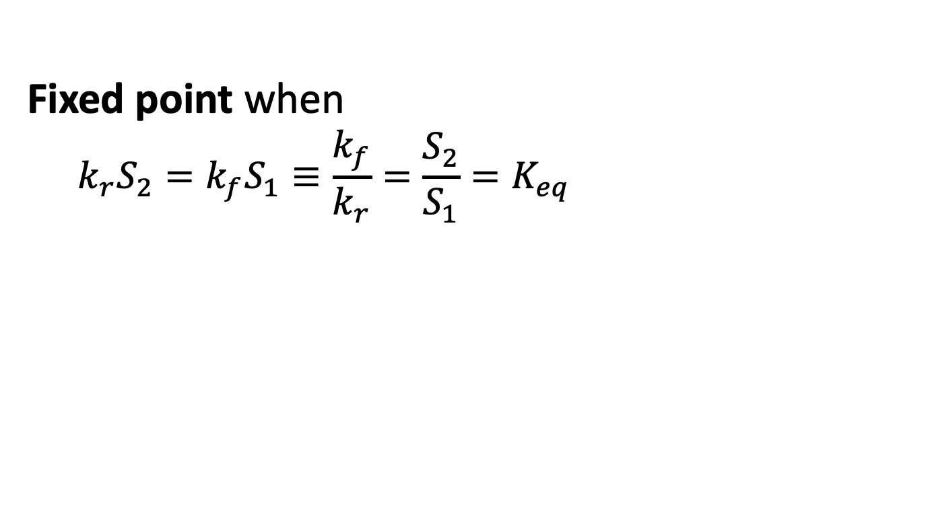
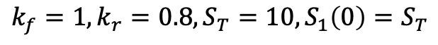
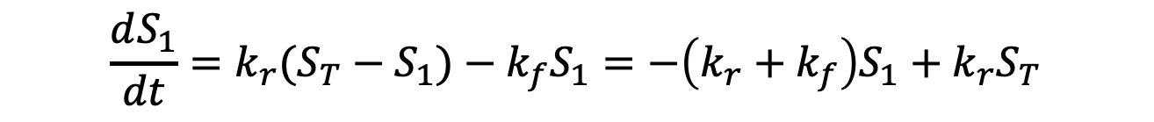
Fixed Points
$$\frac{dS_{1}}{dt}=k_{r}{(S_{T}−S}_{1})−k_{f}S_{1}=−\left(k_{r}+k_{f}\right)S_{1}+k_{r}S_{T}$$
Fixed point when
$$k_{r}S_{2}=k_{f}S_{1}≡\frac{k_{f}}{k_{r}}=\frac{S_{2}}{S_{1}}=K_{eq}$$
$$\frac{dS_{1}}{dt}=0$$
$$k_{f}=1,k_{r}=0.8,S_{T}=10,S_{1}\left(0\right)=S_{T}$$

Slide 8
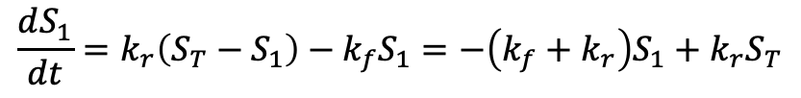
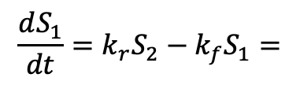
Plotting the Dynamical System
$$\frac{dS_{1}}{dt}=k_{r}S_{2}−k_{f}S_{1}=$$
$$\frac{dS_{1}}{dt}=k_{r}\left(S_{T}−S_{1}\right)−k_{f}S_{1}=−\left(k_{f}+k_{r}\right)S_{1}+k_{r}S_{T}$$
Use S1TOT, S2TOT
Plot dS2, S2. Show fixed point. Change with initial?

Slide 9
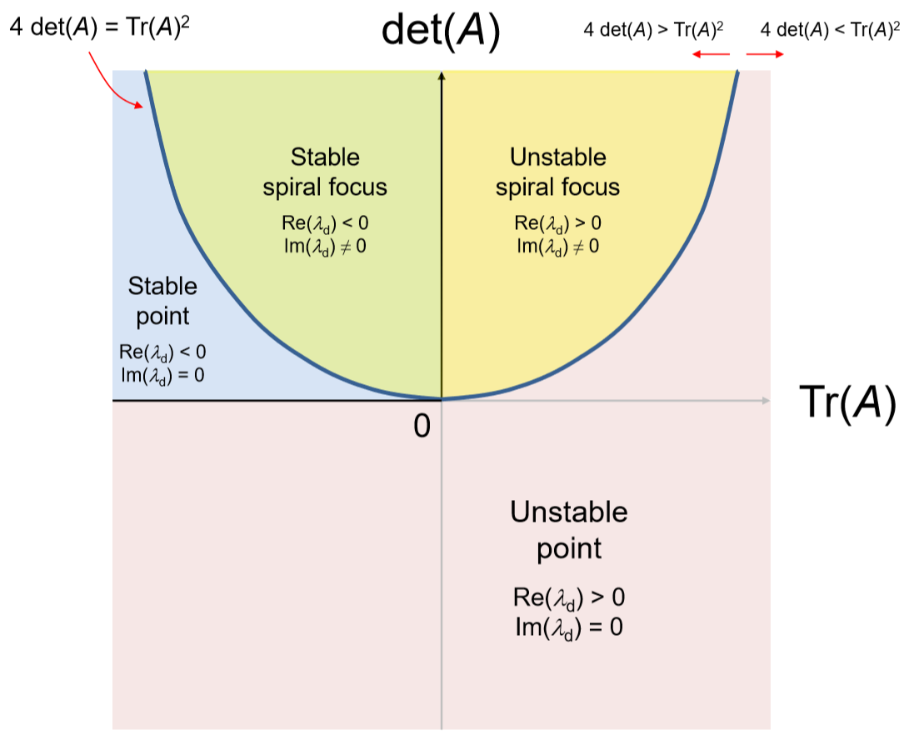
Types of Linear Fixed Points

Slide 10
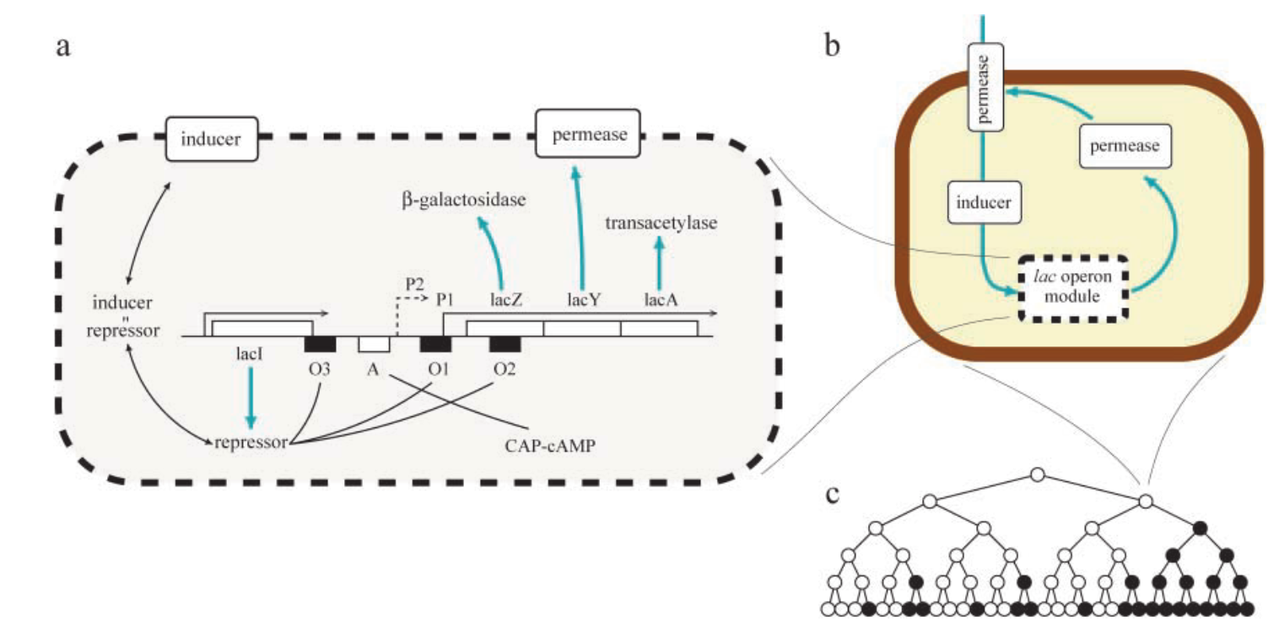
How Yeast Adapts: lac operon
Adaptations
Allow lactose into the cell
Convert lactose to galactose and glucose
*Vilar et al., 2003. Journal of Cell Biology.

Slide 11
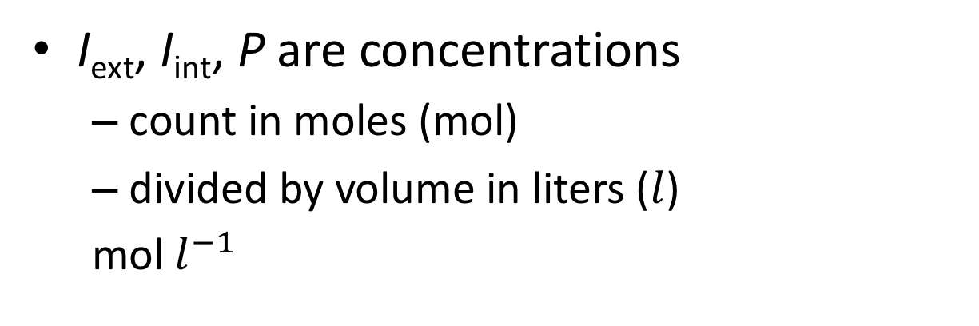
Modeling the lac Operon
I_{ext}
System Diagram
P
I_{int}
I_{ext} = external inducer (lactose)
I_{int} = internal inducer
P = permease
*Vilar et al., 2003. Journal of Cell Biology.
I_{ext}, I_{int}, P are concentrations
count in moles (mol)
divided by volume in liters ($l$)
mol $l^{−1}$

Slide 12
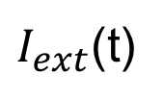
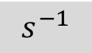
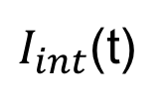
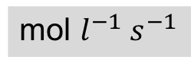
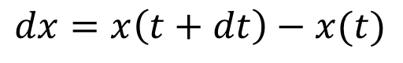
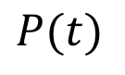
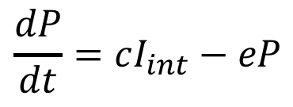
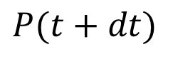
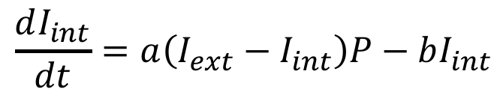
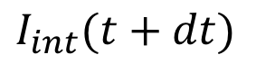
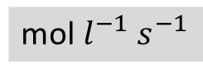
Modeling the lac Operon
I_{ext}
System Diagram
P
Simplified System Diagram
I_{int}
Conceptual Model
Technical Model
$I_{ext}$(t)
$I_{int}$(t)
$$P(t)$$
$$dx=x\left(t+dt\right)−x(t)$$
*Vilar et al., 2003. Journal of Cell Biology.
1:
$$\frac{dI_{int}}{dt}=a\left(I_{ext}−I_{int}\right)P−bI_{int}$$
1
2
$$\frac{dP}{dt}=cI_{int}−eP$$
$$I_{int}(t+dt)$$
$$P(t+dt)$$
2:
Questions
What are the units of dP/dt?
What are the units of c?
What are the units of a?
mol $l^{−1} s^{−1}$
$$s^{−1}$$
mol $l^{−1} s^{−1}$
Notes:
State vs. input variables for time?

Slide 13
What We Assume Using a Model Based on Differential Equations
The system is deterministic
Repeated experiments produce essentially the same results
Counter example: Individual chemical reactions
Variables are continuous
Counter example: Small number of molecules

Slide 14
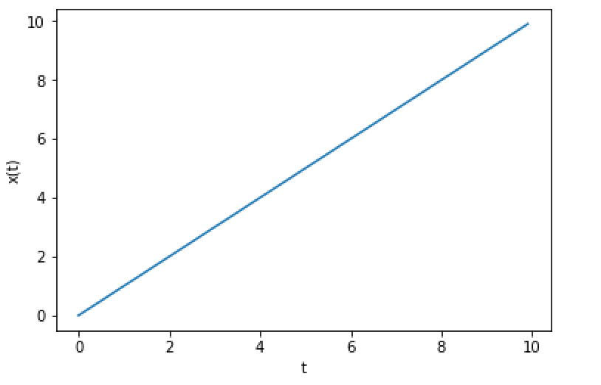
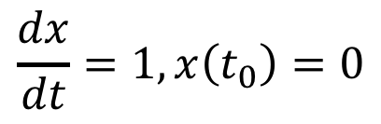
Solving Differential Equations Initial Value Problem (IVP)
Given derivative of variables and their initial values.
Find values of variables over time.
$$\frac{dx}{dt}=1, x\left(t_{0}\right)=0$$
Example:
Graphical solution
Place a point at initial value.
Draw a line with slope equal to the derivative.

Slide 15
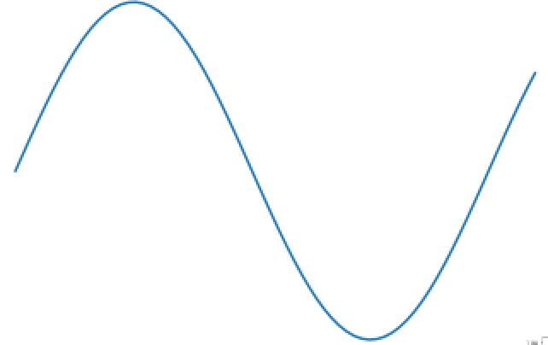
A More Elaborate Initial Value Problem
Draw the curve
Initial value
Derivative

Slide 16
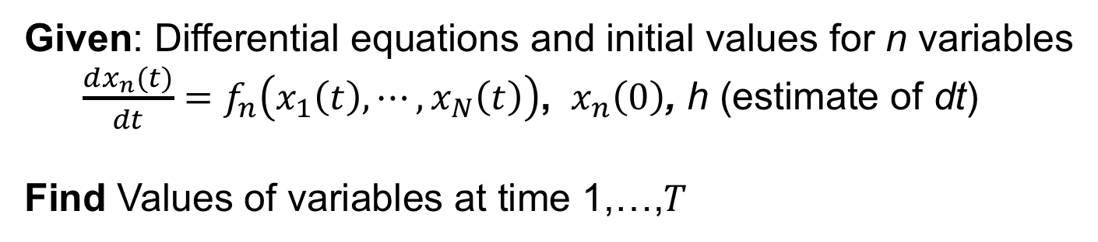
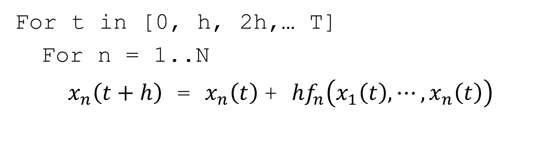
Euler Algorithm for IVP
Given: Differential equations and initial values for n variables
$\frac{dx_{n}(t)}{dt}=f_{n}\left(x_{1}\left(t\right),⋯,x_{N}\left(t\right)\right)$, ${ x}_{n}\left(0\right)$, h (estimate of dt)
Find Values of variables at time 1,…,$T$
For t in [0, h, 2h,… T]
For n = 1..N
$x_{n}\left(t+h\right)$ = $x_{n}\left(t\right)$+ ${hf}_{n}\left(x_{1}\left(t\right),⋯,x_{n}\left(t\right)\right)$

Slide 17
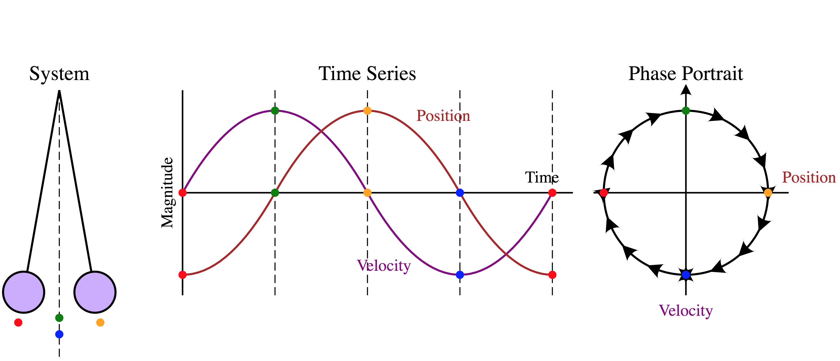
Phase Portrait
Geometric representation of how variables change.

Slide 18
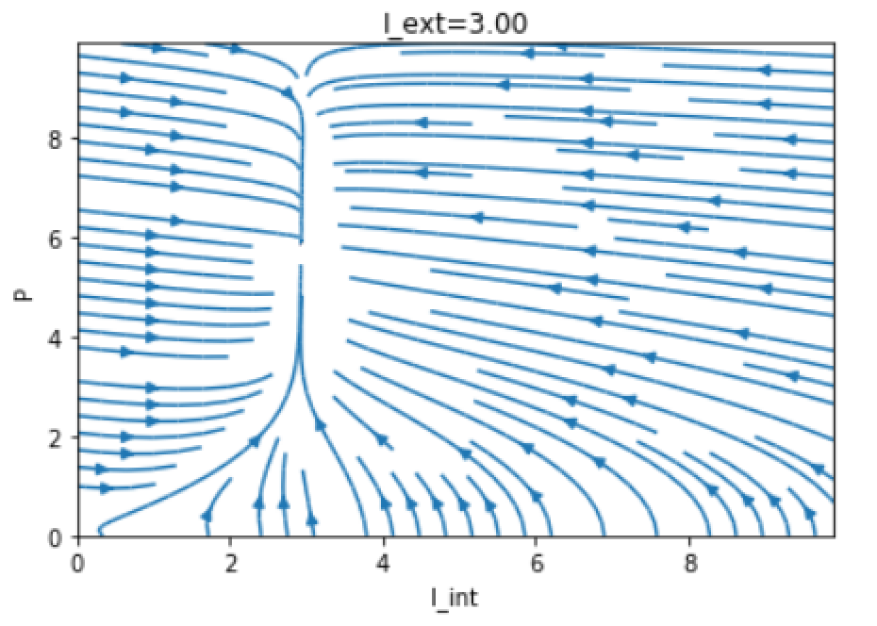
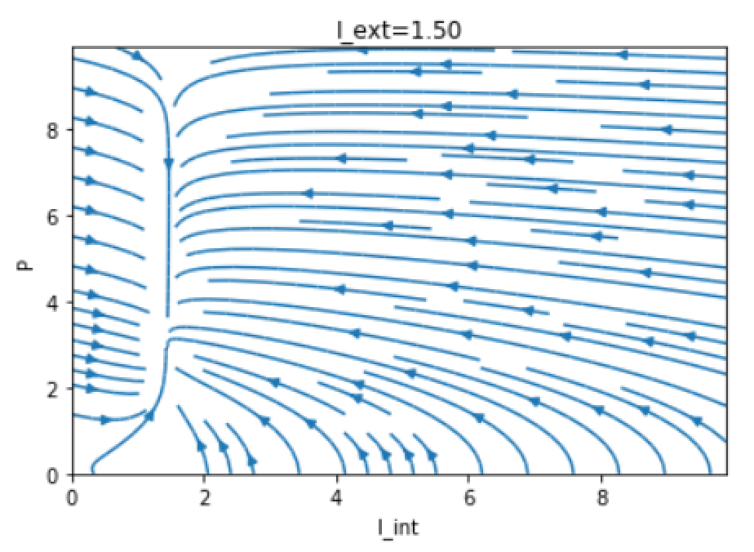
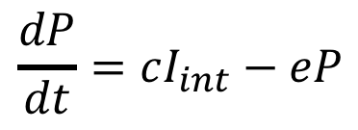
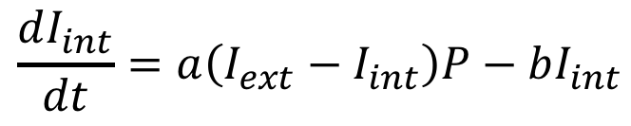
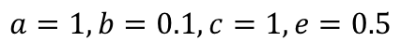
Phase Portrait For lac Operon Model
$$\frac{dI_{int}}{dt}=a\left(I_{ext}−I_{int}\right)P−bI_{int}$$
$$\frac{dP}{dt}=cI_{int}−eP$$
Fixed point: All derivatives are 0.
Stable fixed point: Stays at fixed point.
$$a=1, b=0.1, c=1, e=0.5$$

Slide 19
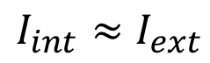
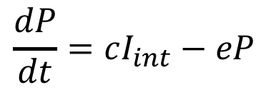
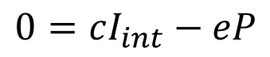
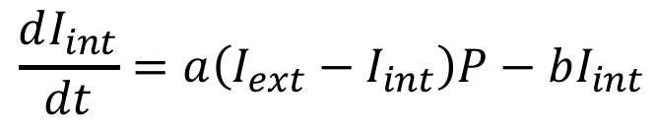
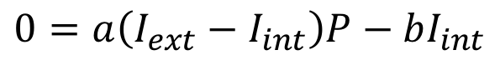
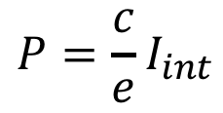
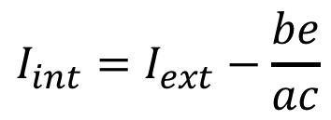
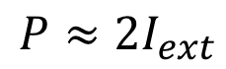
Finding Fixed Points
Solve for variable values when derivatives are 0.
lac operon model
$$\frac{dI_{int}}{dt}=a\left(I_{ext}−I_{int}\right)P−bI_{int}$$
$$\frac{dP}{dt}=cI_{int}−eP$$
$$0=a\left(I_{ext}−I_{int}\right)P−bI_{int}$$
$$0=cI_{int}−eP$$
Solving:
$${I_{int}=I}_{ext}−\frac{be}{ac}$$
$$P=\frac{c}{e}I_{int}$$
For the values used:
$${I_{int}≈I}_{ext}$$
$$P≈2I_{ext}$$

Slide 20
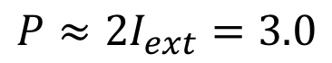
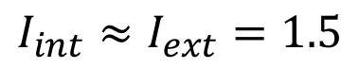
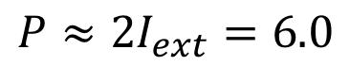
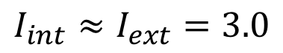
Relating Steady Calculations to Phase Portrait
$${I_{int}≈I}_{ext}=3.0$$
$${I_{int}≈I}_{ext}=1.5$$
$$P≈2I_{ext}=6.0$$
$$P≈2I_{ext}=3.0$$

Slide 21


Types of Differential Equations
Ordinary differential equations
Only take derivative with respect to a single variable (e.g., time)
Partial differential equations have derivatives with respect to many variables
Linear differential equations
No products (or other functions) of variables being differentiated
We mostly have non-linear, ordinary differential equations
$$\frac{dI_{int}}{dt}=a\left(I_{ext}−I_{int}\right)P−bI_{int}$$
$$\frac{dP}{dt}=cI_{int}−eP$$

Slide 22











Differential Equations for Chemical Reactions
Differential
Equation
Reaction
Kinetics
$$A→B$$
$$kA$$
$$\frac{dA}{dt}=−kA$$
$$A+B→C$$
$$kAB$$
$$\frac{dA}{dt}=\frac{dB}{dt}=−kAB$$
$$A→B+C$$
$$kA$$
$$\frac{dA}{dt}=−kA$$
$$A+B→C+D$$
$$kAB$$
$$\frac{dA}{dt}=\frac{dB}{dt}=−kAB$$

Slide 23




How Concentrations Change
Reaction
Differential
Equation
Kinetics
$$A→B$$
$$kA$$
$$\frac{dA}{dt}=−kA$$

Slide 24
Agenda
Differential equations
Definition, fixed points
Linear differential equations
Definition, behaviors
Uni-reaction
Nonlinear differential equations
Why: non-uni, enzymes
Classifications
Linearization -> classifications
Phase diagrams
Bifurcation plots

Slide 25
BACKUP

Slide 26




Chemical Kinetics Basics
How fast do reactions go:
Mass action kinetics
Constant times the concentrations of the reactants
$$v_{f}$$
$$v_{f}$$
$$A+B→C+D$$
$$v_{f}=k∗A∗B$$

Slide 27









Reversible Reactions & Steady State
$$←$$
$$v_{f}$$
Reversible reaction ex:
What are the concentrations of reactants and products when the reactions have run for a long time? This occurs when $v_{f}=v_{r}$.
Mass action kinetics steady state
$$AB$$
$$←$$
$A+B$
$$v_{r}$$
$$v_{f}=v_{r}≡ k_{f}∗AB−k_{r}∗A∗B=0$$
Disassociation Constant
$$K_{D}=\frac{k_{f}}{k_{r}}=\frac{A∗B}{AB}$$

Slide 28
Biochemical Reactions
Reactant
Molecules
Product
Molecules
Enzyme
But Arcs are often bidirectional
(since chemical reactions can be reversed)
And enzymes may be modified in pathway regulation
(self-modifying code!)
Another Enzyme

Slide 29
Enzymes
Proteins that accelerate biochemical reactions.
Omni-present in biology
Enzymes work by induced fit.

Slide 30

Enzymes and Reaction Kinetics
Notes:
Ask about the rates at each step.

Slide 31



Enzyme Inhibition
Competitive Inhibition
S
ES
Noncompetitive Inhibition

Slide 32
G.P.E. Box (Famous Statistician)
All models are wrong.
But some models are useful.

Slide 33
Agenda
Conceptual models
Variables and relationships
Dimensional analysis
Modeling Workflow
Example: Modeling the lac operon
Technical models with differential equations
Technical models with Markov Models
Review
Lecture Notes

Slide 34



A Motivating Example: Modeling Water Flows and Levels for a Reservoir
$Q_{1}\left(t\right)$= flow in
(m³s⁻¹)
$h\left(t\right)$= water height
(m)
$Q_{2}\left(t\right)$= flow out
(m³s⁻¹)
m = meters
s = seconds
Notes:
What happens if height is too high? Limit of model?

Slide 35






A conceptual model specifies variables and their roles.
$$Q_{1}\left(t\right)$$
$$h\left(t\right)$$
$$Q_{2}\left(t\right)$$
$$Q_{1}\left(t\right)$$
Variable Roles
Input. Exogenous variable that does not depend on the model.
Output. Computed variable of interest to the modeler.
State: Computed variable used to calculate output variables and/or other state variables.
Calculations
$$h\left(t\right)$$
$$Q_{2}\left(t\right)$$

Slide 36







Technical models detail calculations.
$$Q_{1}\left(t\right)$$
$$h\left(t\right)$$
Initial Technical Model
$$Q_{2}\left(t\right)$$
$$\frac{dh\left(t\right)}{dt}={a(Q}_{2}(t)−Q_{1}(t)), h\left(t\right)>0$$
Issues
What if h(t) exceeds the height of the dam?
How is $a$ obtained?
Estimating $a$
If the reservoir is a cylinder with radius r, then $a=\frac{1}{πr^{2}}$
Technical Model if $h\left(u\right)>0, h\left(0\right)=H_{0}$
$$h\left(t\right)=\int_{0}{ \frac{{Q_{2}\left(u\right)−Q}_{1}\left(u\right)}{πr^{2}}du+H_{0}}$$
t

Slide 37
The reservoir is a cylinder?
The model is wrong.
But the model may be useful.

Slide 38
Steps In Modeling
Define the system boundaries, components, and available data.
Identify variables, dimensions, units.
Specify assumptions.
Ex: continuous approximations
Use ”mechanics” of system to construct mathematical relationships between variables.
Evaluate model quality and parameter certainties.
Ex: Differences between predicted and observed values.
Repeat.

Slide 39




Modeling Workflow
System Diagram
Conceptual
Model
$$Q_{1}\left(t\right)$$
$$h\left(t\right)$$
$$Q_{2}\left(t\right)$$
V2.out
Technical
Model
$h\left(t\right)=\int_{0}{\frac{{Q_{2}\left(u\right)−Q}_{1}\left(u\right)}{πr^{2}}du}+H_{0}$
t

Slide 40
Model Characteristics
Linear vs. nonlinear
Static vs. dynamic
For dynamic: Time varying vs. time invariant
Lumped or distributed parameters
Deterministic vs. stochastic

Slide 41
Assumptions (Approximations)
Neglecting small effects (e.g., noise)
Environment does not change
Ex: Steady state
Replace a complex system with a lumped system
Linear relationship

Slide 42






Dimensional Analysis
Why dimensional analysis?
Ensure consistent units.
Validate mathematical models.
Derive mathematical models.
$$dh\left(t\right)={a(Q}_{2}(t)−Q_{1}(t))dt$$
Height model
}
}
}
}
}
$$m$$
$$x$$
$$m^{3}s^{−1}$$
$$m^{3}s^{−1}$$
$$s^{}$$
Units

Slide 43
Rules for Dimensional Analysis
The units for a variable expression are that expression applied to the units of the variables.
Multiplying (dividing) units creates a compound unit.
Adding (subtracting) the same units gives the same units. Adding different units is undefined.
The units must be the same on both sides of an equals sign.
The arguments of transcendental functions (e.g., natural log) must be unitless.

Slide 44










Solving for the units of $a$
$$dh\left(t\right)={a(Q}_{2}(t)−Q_{1}(t))dt$$
Rules
The units for a variable expression are that expression applied to the units of the variables.
Multiplying (dividing) units creates a compound unit.
Adding (subtracting) the same units gives the same units. Adding different units is undefined.
The units must be the same on both sides of an equals sign.
The arguments of transcendental functions (e.g., natural log) must be unitless.
}
}
}
}
}
$$m$$
$$x$$
$$m^{3}s^{−1}$$
$$m^{3}s^{−1}$$
$$s^{}$$
By Rules 1 & 4:
$$m=x\left(m^{3}s^{−1}−m^{3}s^{−1}\right)s$$
By Rule 3:
$$m=x(m^{3}s^{−1})s$$
By multiplication:
$$m=xm^{3}$$
By division:
$$x=m^{−2}$$

Slide 45

Modeling Example: lac Operon
Problem: yeast prefer glucose but sometimes only have access to lactose.

Slide 46
When Should Yeast Adapt?
Glucose | Lactose | lac Operon Transcription
+ | - | No adaptation
+ | + | Low adaptation
- | - | No adaptation
- | + | Strong adaptation

Slide 47
How Yeast Adapts: lac operon
Adaptations
Allow lactose into the cell
Convert lactose to galactose and glucose
*Vilar et al., 2003. Journal of Cell Biology.

Slide 48
Modeling the lac Operon
I_{ext}
System Diagram
P
I_{int}
I_{ext} = external inducer (lactose)
I_{int} = internal inducer
P = permease
*Vilar et al., 2003. Journal of Cell Biology.
I_{ext}, I_{int}, P are concentrations
count in moles (mol)
divided by volume in liters ($l$)
mol $l^{−1}$

Slide 49
Modeling the lac Operon
I_{ext}
System Diagram
P
Simplified System Diagram
I_{int}
Conceptual Model
Technical Model
$I_{ext}$(t)
$I_{int}$(t)
$$P(t)$$
$$dx=x\left(t+dt\right)−x(t)$$
*Vilar et al., 2003. Journal of Cell Biology.
1:
$$\frac{dI_{int}}{dt}=a\left(I_{ext}−I_{int}\right)P−bI_{int}$$
1
2
$$\frac{dP}{dt}=cI_{int}−eP$$
$$I_{int}(t+dt)$$
$$P(t+dt)$$
2:
Questions
What are the units of dP/dt?
What are the units of c?
What are the units of a?
mol $l^{−1} s^{−1}$
$$s^{−1}$$
mol $l^{−1} s^{−1}$
Notes:
State vs. input variables for time?

Slide 50








Technical Models With Differential Equations
Differential equations describe how variables change, typically with respect to time.
A differential is a small change
$dt$ is a small change in $t$
$dx(t)$ is the change from $x(t)$ to $x(t+dt)$
Lac operon: Concentration of inducer and permease
$I_{ext}$(t)
$I_{int}$(t)
$$P(t)$$
$$\frac{dI_{int}}{dt}=a\left(I_{ext}−I_{int}\right)P−bI_{int}$$
1
2
$$\frac{dP}{dt}=cI_{int}−eP$$
$$I_{int}(t+dt)$$
$$P(t+dt)$$

Slide 51
What We Assume Using a Model Based on Differential Equations
The system is deterministic
Repeated experiments produce essentially the same results
Counter example: Individual chemical reactions
Variables are continuous
Counter example: Small number of molecules

Slide 52
Solving Differential Equations Initial Value Problem (IVP)
Given derivative of variables and their initial values.
Find values of variables over time.
$$\frac{dx}{dt}=1, x\left(t_{0}\right)=0$$
Example:
Graphical solution
Place a point at initial value.
Draw a line with slope equal to the derivative.

Slide 53
A More Elaborate Initial Value Problem
Draw the curve
Initial value
Derivative

Slide 54
Euler Algorithm for IVP
Given: Differential equations and initial values for n variables
$\frac{dx_{n}(t)}{dt}=f_{n}\left(x_{1}\left(t\right),⋯,x_{N}\left(t\right)\right)$, ${ x}_{n}\left(0\right)$, h (estimate of dt)
Find Values of variables at time 1,…,$T$
For t in [0, h, 2h,… T]
For n = 1..N
$x_{n}\left(t+h\right)$ = $x_{n}\left(t\right)$+ ${hf}_{n}\left(x_{1}\left(t\right),⋯,x_{n}\left(t\right)\right)$

Slide 55
Phase Portrait
Geometric representation of how variables change.

Slide 56
Phase Portrait For lac Operon Model
$$\frac{dI_{int}}{dt}=a\left(I_{ext}−I_{int}\right)P−bI_{int}$$
$$\frac{dP}{dt}=cI_{int}−eP$$
Fixed point: All derivatives are 0.
Stable fixed point: Stays at fixed point.
$$a=1, b=0.1, c=1, e=0.5$$

Slide 57
Finding Fixed Points
Solve for variable values when derivatives are 0.
lac operon model
$$\frac{dI_{int}}{dt}=a\left(I_{ext}−I_{int}\right)P−bI_{int}$$
$$\frac{dP}{dt}=cI_{int}−eP$$
$$0=a\left(I_{ext}−I_{int}\right)P−bI_{int}$$
$$0=cI_{int}−eP$$
Solving:
$${I_{int}=I}_{ext}−\frac{be}{ac}$$
$$P=\frac{c}{e}I_{int}$$
For the values used:
$${I_{int}≈I}_{ext}$$
$$P≈2I_{ext}$$

Slide 58
Relating Steady Calculations to Phase Portrait
$${I_{int}≈I}_{ext}=3.0$$
$${I_{int}≈I}_{ext}=1.5$$
$$P≈2I_{ext}=6.0$$
$$P≈2I_{ext}=3.0$$

Slide 59
Types of Differential Equations
Ordinary differential equations
Only take derivative with respect to a single variable (e.g., time)
Partial differential equations have derivatives with respect to many variables
Linear differential equations
No products (or other functions) of variables being differentiated
We mostly have non-linear, ordinary differential equations
$$\frac{dI_{int}}{dt}=a\left(I_{ext}−I_{int}\right)P−bI_{int}$$
$$\frac{dP}{dt}=cI_{int}−eP$$

Slide 60
Differential Equations for Chemical Reactions
Differential
Equation
Reaction
Kinetics
$$A→B$$
$$kA$$
$$\frac{dA}{dt}=−kA$$
$$A+B→C$$
$$kAB$$
$$\frac{dA}{dt}=\frac{dB}{dt}=−kAB$$
$$A→B+C$$
$$kA$$
$$\frac{dA}{dt}=−kA$$
$$A+B→C+D$$
$$kAB$$
$$\frac{dA}{dt}=\frac{dB}{dt}=−kAB$$

Slide 61
How Concentrations Change
Reaction
Differential
Equation
Kinetics
$$A→B$$
$$kA$$
$$\frac{dA}{dt}=−kA$$

Slide 62

Technical Models With Markov Models
Motivation
Address situations where there are few molecules (e.g., low expression rates)

Slide 63




Markov Model Core Concepts
States: Specifies variable values that completely characterize how the system behaves
Transition rates: Probability per time unit of the system moving from state to state
State 1
$$r_{11}$$
State Diagram
$$r_{1N}$$
State N
$$r_{N,1}$$
$$r_{NN}$$

Slide 64



Markov Model Example:
$$A→B$$
State: Number of molecules of A (or B)
Transition: Change in the number of molecules of A as a result of a reaction
Each molecule of A reacts at a constant rate
$$λ$$
$$Nλ$$
$$λ$$
N
N-1
0
Notes:
Why are there only arrows between adjacent states? Why is the last array lambda?

Slide 65

Deterministic vs. Stochastic Model
Deterministic
(Differential Equation)
Stochastic

Slide 66


Effect of the Number of Molecules
100
10
1000

Slide 67






Markov Model Example:
$$A↔B$$
States?
Molecules of A
N is the sum of the molecules of A, B
State Diagram?
$$Nλ_{A}$$
$$2λ_{A}$$
$$Nλ_{B}$$
N
N-1
1
0
$$λ_{B}$$
$$λ_{A}$$
Notes:
Why are there only arrows between adjacent states? Why is the last array lambda?
B arrows go to the left; A arrows go to the right.

Slide 68
Data Sources
Who do I get…
Pathways, kinetics constants, gene networks, …
Metabolic pathways
Metabolic reconstruction (http://bigg.ucsd.edu/)
KEGG (https://www.genome.jp/kegg/)
MetaCyc (https://metacyc.org/)

Slide 69
Review
Conceptual model and variable roles
Input, output, state
Dimensional analysis
Rules
Modeling workflow
System diagram, conceptual model, technical model
Technical model: differential equations
Graphical solution
Technical model: Markov Model
State, transition, transition rates

Slide 70
BACKUP

Slide 71
Vocabulary for Modeling With Differential Equations
Increase
Decrease
With minimum
With maximum
Jointly increase with
Jointly decrease with
Activated by
Inhibited by

Slide 72
Notes
Modeling sequence
Population growth
Logistic regression for population min and max
Predatory prey
Consumption production
Activation/inhibition cascades
Types of stability. Linear vs. non-linear
Phase space
Key concepts
Falsifiable, accurate, predictive, parsimonious, selective (what is modelled), validation (establish relationship with experimental data)

